Slide 1
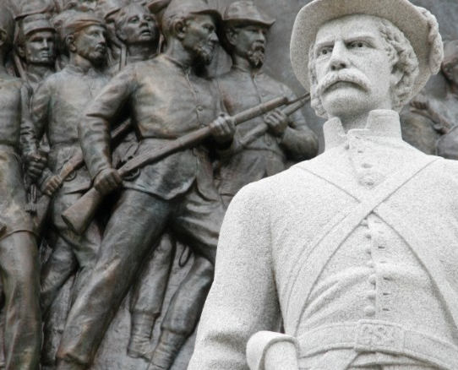
REMOVAL OF CONFEDERATE Statues and flags
Confederate Statues and Flags should be Brought Down
Notes:
NOTE:
To change the image on this slide, select the picture and delete it. Then click the Pictures icon in the placeholder to insert your own image.

Slide 2
Confederate Statues
They are physical statues that were erected mostly in the south to depict confederacy.
They were erected during struggle for equality.
Some were also erected during the American civil war
They are of various people who rose to prominence at the time.
A debate exists of whether to remove them or not
Notes:
Some people argue that confederate states should be removed while others support that they should remain standing. Both sides have their reasons. Despite the existing opposite views

Slide 3
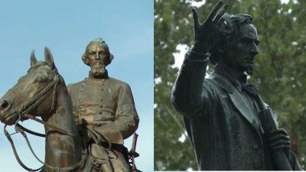
Mixed feeling about confederate statues.
Notes:
A heated debate has ensured and some of the confederate statues have been brough down but some are still standing. The main reason being differences in opinions about the stsues and the purposes they serve among Americans.
The picture above is from https://wreg.com/2018/12/17/candlelight-vigil-planned-to-mark-anniversary-of-confederate-statues-removal/

Slide 4
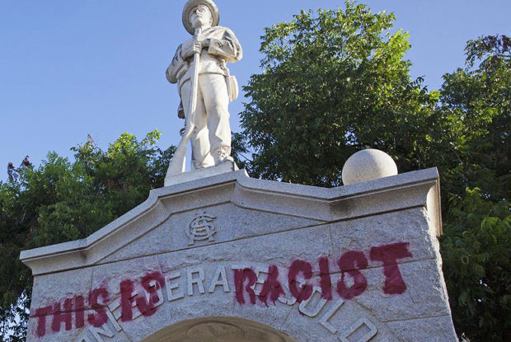
1. Confederate statues extend racial inequality
Supporters of confederate statues believe in white supremacy point of view
Statues elongate the white supremacy that showed inequality in America
They should be demolished for being racist as shown in the image
Image from https://cele.sog.unc.edu/the-danger-of-confederate-statues-and-the-danger-of-removing-them/

Slide 5
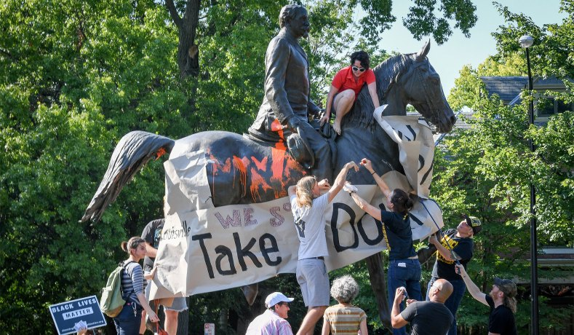
2. Confederate statutes encourage divisions among Americans
Opposite views about the statues tear Americans apart.
Cohesion depreciates due to the statues.
The debate relives the dark days of inequality
Image source https://edition.cnn.com/2017/08/15/us/confederate-memorial-removal-us-trnd/index.html
Notes:
Americans differ about these statues and instead of having some who are discontented with them, it would be better to bring them down to end the tdebate that reminds many of the dark days of racial inequality in America.

Slide 6
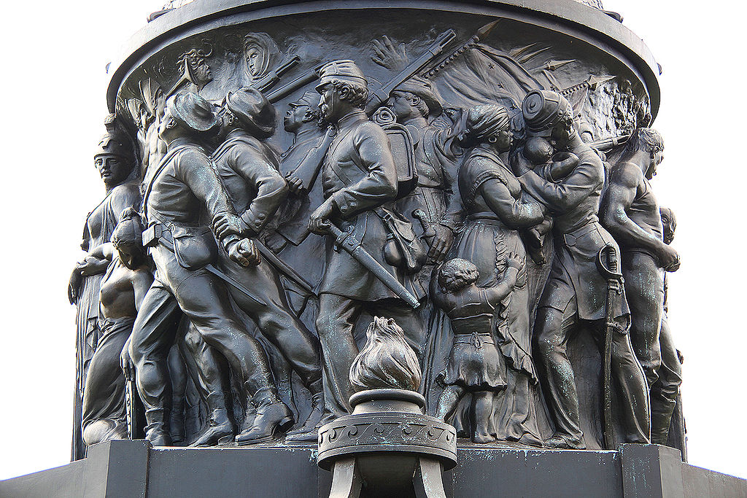
3. Confederate statues remind Americans of the dark times in the history.
Most statues of confederacy are icons who rose to power during the American civil war (Sawchuk 2).
Some of them tortured African Americans
They did so through slavery.
Whites were considered supreme to African Americans.
Statues of confederacy relives these dark times so they should be removed.
Notes:
If there is something that Americans do not want to remember is the fight for equality. Discrimination and white supremacy brough a lot of suffering to African Americans and these confederate statues remind many African Americans of the dark times (Anastasia 2). As such, it is hard for them to accept them. They should therefore be brought down to erase these sad memory.

Slide 7
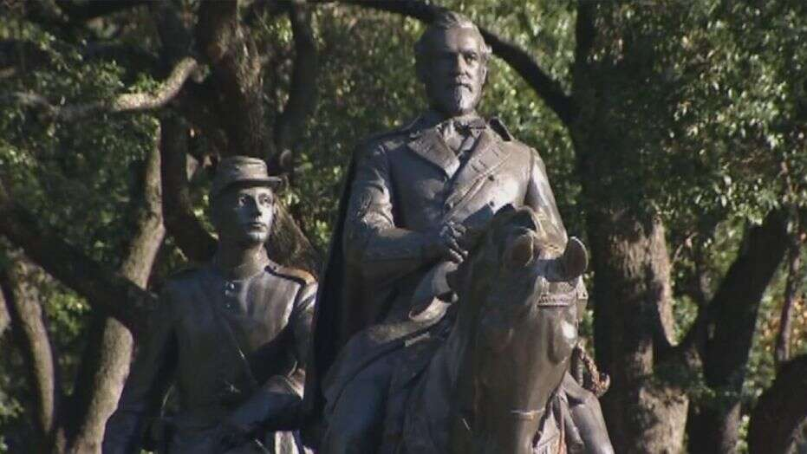
Proponents argue that the icons represent the history of America
Those in support view confederate statues as a rich conservation of Americas history.
That is true but the negative effects with which that history comes is enormous to ignore.
Confederate statues should be brough down to safeguard the democracy and equality that the country has already achieved.
Notes:
the argument that the statues serve as a remind of the Americans’ history is weak to submerge the emotional hate that they elicit in those who remember the days of slavery especially in the southern parts of the US (Buffington 45).

Slide 8
Works Cited
Anastasia, Laura. "Monumental Battle: Why a push to remove Confederate monuments has sparked violence, protests, and heated debate." Junior Scholastic/Current Events, 18 Sept. 2017, p. 6+. Opposing Viewpoints in Context, http://link.galegroup.com/apps/doc/A512184675/OVIC?u=lincclin_ircc&sid=OVIC&xid=ddb881b7. Accessed 20 November. 2018.
Buffington, Melanie L. "Contemporary culture wars: Challenging the legacy of the Confederacy." Journal of Cultural Research in Art Education 34 (2017).
Sawchuk, Stephen. "Are Confederate-Statue Controversies Teachable Moments? Efforts to remove Confederate statues stoke class discussions." Education Week, 21 June 2017, p. 1. Opposing Viewpoints in Context, http://link.galegroup.com/apps/doc/A497616055/OVIC?u=lincclin_ircc&sid=OVIC&xid=c10c8ed7. Accessed 20 November. 2018.
Suerth, Jessica. Here are the Confederate memorials that will be removed after Charlottesville. 2017. Accessed at https://edition.cnn.com/2017/08/15/us/confederate-memorial-removal-us-trnd/index.html

